Slide 1
Management
Eleventh Edition
Chapter 4
Managing Diversity
Copyright © 2018, 2016, 2014 Pearson Education, Inc. All Rights Reserved

Slide 2
What is Workplace Diversity?
Dictionary definitions of diversity refer to variety, differences, multiformity (instead of uniformity), or dissimilarities (instead of similarities)
Workforce diversity: the ways in which people in an organization are different from and similar to one another
Notes:
Diversity has been “one of the most popular business topics over the last two decades.” It ranks with modern business disciplines such as quality, leadership, and ethics. Despite this popularity, it’s also one of the most controversial and least understood topics. With its basis in civil rights legislation and social justice, the word diversity often invokes a variety of attitudes and emotional responses in people.
So, what’s our definition of workplace diversity? We’re defining it as the ways in which people in an organization are different from and similar to one another. Notice that our definition not only focuses on the differences, but the similarities, of employees. This reinforces our belief that managers and organizations should view employees as having qualities in common as well as differences that separate them.

Slide 3
Types of Diversity
Surface-level diversity: Easily perceived differences that may trigger certain stereotypes, but that do not necessarily reflect the ways people think or feel. (age, race, gender, ethnicity)
Deep-level diversity: Differences in values, personality, and work preferences.
Deep-level differences can affect the way people view organizational work rewards, communicate, react to leaders, negotiate, and generally behave at work.
Notes:
The demographic characteristics that we tend to think of when we think of diversity—age, race, gender, ethnicity, and so on—are just the tip of the iceberg. These demographic differences reflect surface-level diversity, which are easily perceived differences that may trigger certain stereotypes but that do not necessarily reflect the ways people think or feel. Such surface-level differences in characteristics can affect the way people perceive others, especially when it comes to assumptions or stereotyping.
As people get to know one another, these surface-level differences become less important and deep-level diversity—differences in values, personality, and work preferences—becomes more important. These deep-level differences can affect the way people view organizational work rewards, communicate, react to leaders, negotiate, and generally behave at work.

Slide 4
Why is Managing Workplace Diversity So Important?
The benefits of managing workforce diversity fall into three categories:
People management (attracting and retaining talent,
Organizational performance
Strategic
Notes:
Diversity is, after all, about people, both inside and outside the organization. The people management benefits that organizations get because of their workforce diversity efforts revolve around attracting and retaining a talented workforce.
Performance benefits that organizations get from workforce diversity include cost savings and improvements in organizational functioning. The cost savings can be significant when organizations that cultivate a diverse workforce reduce employee turnover, absenteeism, and the chance of lawsuits.
Organizations also benefit strategically from a diverse workforce. You have to look at managing workforce diversity as the key to extracting the best talent, performance, market share, and suppliers from a diverse country and world. One important strategic benefit is that with a diverse workforce, organizations can better anticipate and respond to changing consumer needs. Diverse employees bring a variety of points of view and approaches to opportunities, which can improve how the organization markets to diverse consumers.

Slide 5
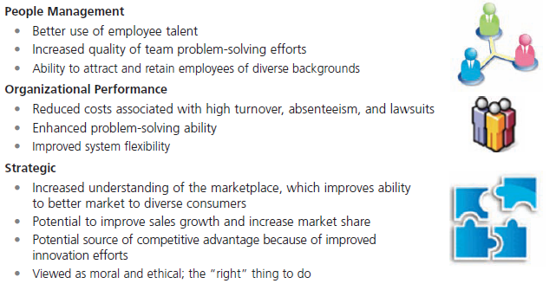
Exhibit 4-2 Benefits of Workforce Diversity
People Management
Better use of employee talent
Increased quality of team problem-solving efforts
Ability to attract and retain employees of diverse backgrounds
Organizational Performance
Reduced costs associated with high turnover, absenteeism, and lawsuits
Enhanced problem-solving ability
Improved system flexibility (processes and procedures be more accommodative)
Strategic
Increased understanding of the marketplace, which improves ability to better market to diverse consumers
Potential to improve sales growth and increase market share
Potential source of competitive advantage because of improved innovation efforts
Viewed as moral and ethical; the "right " thing to do
Exhibit 4-2 shows the three main categories of workforce diversity benefits: people management, organizational performance, and strategic.

Slide 6
Exhibit 4-5 Types of Diversity Found in Workplaces
Exhibit 4-5 shows several types of workplace diversity.
Notes:
As we’ve seen so far, diversity is a big issue, and an important issue, in today’s workplaces. What types of dissimilarities—that is, diversity—do we find in those workplaces? Exhibit 5-5 shows several types of workplace diversity. Let’s work our way through the different types.

Slide 7
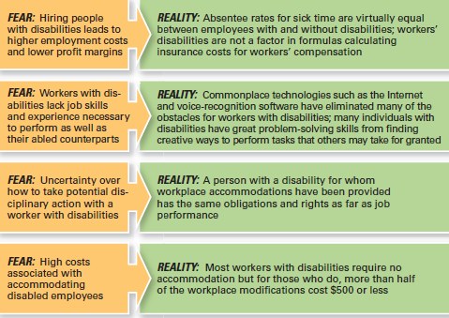
Exhibit 4-6 Employers’ Fears About Disabled Workers
Exhibit 4-6 describes some of employers’ unfounded fears about hiring disabled workers.
Notes:
Even after 20-plus years of the ADA, organizations and managers still have fears about employing disabled workers. A survey by the U.S. Department of Labor looked at these unfounded fears. Exhibit 5-6 describes some of those fears as well as the reality; that is, what it’s really like.
Sources: Based on R. Braum, “Disabled Workers: Employer Fears Are Groundless,” Bloomberg BusinessWeek, October 2, 2009; and “Survey of Employer Perspectives on the Employment of People with Disabilities,” U.S. Department of Labor/Office of Disability Employment Policy, November 2008.

Slide 8
Challenges in Managing Diversity: Personal Bias
Bias: a tendency or preference toward a particular perspective or ideology (one-sided perspective)
Stereotyping: judging a person based on a perception of a group to which that person belongs
Discrimination: when someone acts out their prejudicial attitudes toward people who are the targets of their prejudice
Notes:
Despite the benefits that we know workforce diversity brings to organizations, managers still face challenges in creating accommodating and safe work environments for diverse employees.
Bias is a term that describes a tendency or preference toward a particular perspective or ideology. It’s generally seen as a “one-sided” perspective. Our personal biases cause us to have preconceived opinions about people or things. Such preconceived opinions can create all kinds of inaccurate judgments and attitudes. One outcome of our personal biases can be prejudice, a preconceived belief, opinion, or judgment toward a person or a group of people. Our prejudice can be based on all the types of diversity we discussed: race, gender, ethnicity, age, disability, religion, sexual orientation, or even other personal characteristics.

Slide 9
Exhibit 4-7 Forms of Discrimination
Types of Discrimination | Definition | Examples from Organizations
Discriminatory policies or practices | Actions taken by representatives of the organization that deny equal opportunity to perform or unequal rewards for performance | Older workers may be targeted for layoffs because they are highly paid and have lucrative benefits. ª
Intimidation | Overt threats or bullying directed at members of specific groups of employees | African American employees at some companies have found nooses hanging over their work stations. ^{c}
Mockery and insults | Jokes or negative stereotypes; sometimes the result of jokes taken too far | Arab Americans have been asked at work whether they were carrying bombs or were members of terrorist organizations. ^{d}
Exclusion | Exclusion of certain people from job opportunities, social events, discussions, or informal mentoring; can occur unintentionally | Many women in finance claim they are assigned to marginal job roles or are given light workloads that don’t lead to promotion. ^{e}
Incivility | Disrespectful treatment, including behaving in an aggressive manner, interrupting the person, or ignoring his or her opinions | Female lawyers note that male attorneys frequently cut them off or do not adequately address their comments. ^{f}
Notes:
Notes: a. J. Levitz and P. Shishkin, “More Workers Cite Age Bias After Layoffs,” Wall Street Journal, March 11, 2009, pp.
D1–D2.
W. M. Bulkeley, “A Data-Storage Titan Confronts Bias Claims,” Wall Street Journal, September 12, 2007, pp. A1,
A16.
D. Walker, “Incident with Noose Stirs Old Memories,” McClatchy-Tribune Business News, June 29, 2008; and
D. Solis, “Racial Horror Stories Keep EEOC Busy,” Knight-Ridder Tribune Business News, July 30, 2005, p. 1.
d. H. Ibish and A. Stewart, Report on Hate Crimes and Discrimination Against Arab Americans: The Post-
September 11 Backlash, September 11, 2001–October 11, 2001 (Washington, DC: American-Arab Anti-
Discrimination Committee, 2003).
A. Raghavan, “Wall Street’s Disappearing Women,” Forbes, March 16, 2009, pp. 72–78.
L. M. Cortina, “Unseen Injustice: Incivility as Modern Discrimination in Organizations.”
Source: S. Robbins and T. Judge, Organizational Behavior, 15th ed., Prentice Hall, p. 43.

Slide 10
Glass Ceiling
Glass ceiling: the invisible barrier that separates women and minorities from top management positions (career path for men and women, minorities)
Notes:
In the 1980s, the term glass ceiling, first used in a Wall Street Journal article, refers to the invisible barrier that separates women and minorities from top management positions. The idea of a “ceiling” means something is blocking upward movement and the idea of “glass” is that whatever’s blocking the way isn’t immediately apparent.
Research on the glass ceiling has looked at identifying the organizational practices and interpersonal biases that have blocked women’s advancement. Findings from those studies have ranged from lack of mentoring to sex stereotyping, views that associate masculine traits with leader effectiveness, and bosses’ perceptions of family–work conflict.

Slide 11
Exhibit 4-8 Major Equal Employment Opportunity Laws
Year | Law or Ruling | Description
1963 | Equal Pay Act | Prohibits pay differences for equal work based on gender
1974 (amended in 1972) | Civil Rights Act, Title VII | Prohibits discrimination based on race, color, religion, national origin, or gender
1967 (amended in 1978) | Age Discrimination in Employment Act | Prohibits discrimination against employees 40 years and older
1973 | Rehabilitation Act | Prohibits discrimination against a qualified person with a disability in the federal government as well as retaliation against a person who complained about discrimination
1978 | Pregnancy Discrimination Act | Prohibits discrimination against women in employment decisions on the basis of pregnancy, childbirth, and related medical decisions
1990 | Americans with Disabilities Act | Prohibits discrimination against individuals who have disabilities or chronic illnesses; also requires reasonable accommodations for these individuals
1991 | Civil Rights Act of 1991 | Reaffirms and tightens prohibition of discrimination and gives individuals right to sue for punitive damages
1993 | Family and Medical Leave Act | Gives employees in organizations with 50 or more employees up to 12 weeks of unpaid leave each year for family or medical reasons
2008 | Genetic Information Nondiscrimination Act | Prohibits discrimination against employees or applicants because of genetic information (one’s own or family members’ genetic tests)
2009 | Lilly Ledbetter Fair Pay Act | Changes the statue of limitations on pay discrimination to 180 days from each paycheck
Notes:
The fact is that federal laws have contributed to some of the social change we’ve seen over the last 50-plus years. Failure to comply with federal laws, can be costly and damaging to an organization’s bottom line and reputation. It’s important that managers know what they can and cannot do legally and ensure that all employees understand as well.
However, effectively managing workplace diversity needs to be more than understanding and complying with federal laws. Organizations that are successful at managing diversity use additional diversity initiatives and programs.
Source: U.S. Equal Employment Opportunity Commission, www.eeoc.gov.

Slide 12
Mentoring
Mentoring: a process whereby an experienced organizational member (a mentor) provides advice and guidance to a less experienced member.
Notes:
A sustainable diversity and inclusion strategy must play a central role in decision-making at the highest leadership level and filter down to every level of the company.
Mentoring is a process whereby an experienced organizational member (a mentor) provides advice and guidance to a less-experienced member (a protégé). Mentors usually provide two unique forms of mentoring functions: career development and social support.
A good mentoring program would be aimed at all employees with high potential to move up the organization’s career ladder.

Slide 13
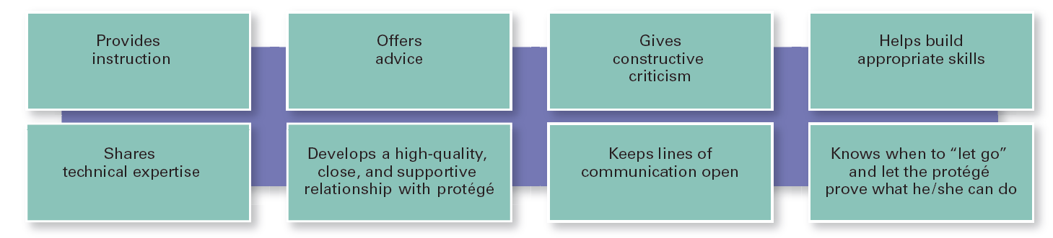
Exhibit 4-9 What a Good Mentor Does
Exhibit 4-9 looks at what a good mentor does.
Notes:
If an organization is serious about its commitment to diversity, it needs to have a mentoring program in place.
Sources: Based on J. Prime and C. A. Moss-Racusin, “Engaging Men in Gender Initiatives: What Change Agents Need to Know,” Catalyst, www.catalyst.org, 2009; T. J. DeLong, J. J. Gabarro, and R. J. Lees, “Why Mentoring Matters in a Hypercompetitive World,” Harvard Business Review, January 2008, pp. 115–121; S. N. Mehta, “Why Mentoring Works,” Fortune, July 9, 2001, p. 119; and D. A. Thomas, “Race Matters: The Truth About Mentoring Minorities,” Harvard Business Review, April 2001, pp. 99–107.

Slide 14
Diversity Skills Training
Diversity skills training: specialized training to educate employees about the importance of diversity and to teach them skills for working in a diverse workplace
Notes:
Our human nature is to not accept or approach anyone who is different from us. But it doesn’t make discrimination of any type or form acceptable. And we live and work in a multicultural context. So the challenge for organizations is to find ways for employees to be effective in dealing with others who aren’t like them. That’s where diversity skills training, specialized training to educate employees about the importance of diversity and teach them skills for working in a diverse workplace, comes in.
Most diversity skills training programs start with diversity awareness training. During this type of training, employees are made aware of the assumptions and biases they may have. Once we recognize that, we can look at increasing our sensitivity and openness to those who are different from us.

Slide 15
Employee Resource Groups
Employee resource groups: groups made up of employees connected by some common dimension of diversity
Notes:
Employee resource groups are made up of employees connected by some common dimension of diversity. Such groups typically are formed by the employees themselves, not the organizations. However, it’s important for organizations to recognize and support these groups.
Why are they so prevalent? The main reason is that diverse groups have the opportunity to see that their existence is acknowledged and that they have the support of people within and outside the group. Individuals in a minority often feel invisible and not important in the overall organizational scheme of things. Employee resource groups provide an opportunity for those individuals to have a voice.

